Slide 1
Chapter 9
Applying Population Ecology:
The Human Population and
Its Impact

Slide 2
HUMAN POPULATION GROWTH:
A BRIEF HISTORY
The human population has grown rapidly because of the expansion of agriculture and industrial production and lower death rates from improvements in hygiene and medicine.
  In 2006, the population of developed countries grew exponentially at 0.1% per year.
  Developing countries grew (15 times faster at 1.5% per year.

Slide 3
Where Are We Headed?
We do not know how long we can continue increasing the earth’s carrying capacity for humans.
  There are likely to be between 7.2-10.6 billion people on earth by 2050.
  97% of growth in developing countries living in acute poverty.
  What is the optimum sustainable population of the earth based on the cultural carrying capacity?

Slide 4
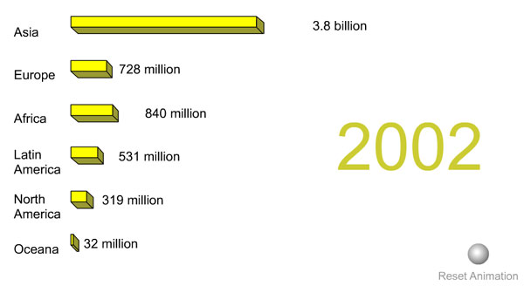
Animation: Current and Projected Population Sizes by Region
PLAY
ANIMATION

Slide 5
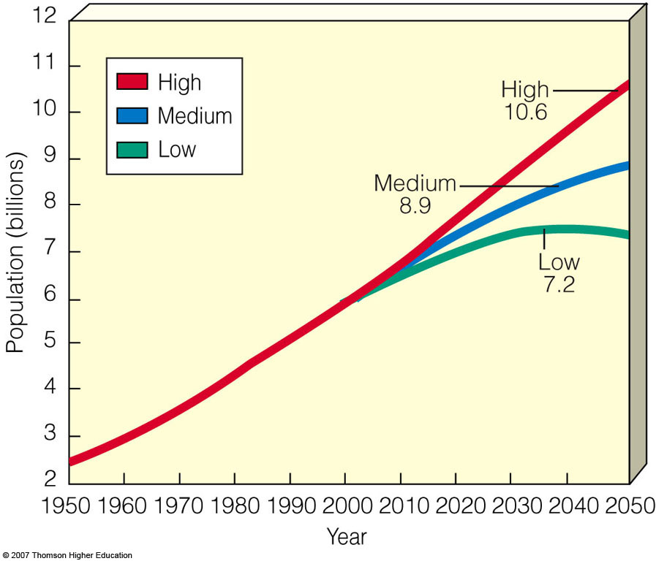
Where Are We Headed?
U.N. world population projection based on women having an average of 2.5 (high), 2.0 (medium), or 1.5 (low) children.

Slide 6
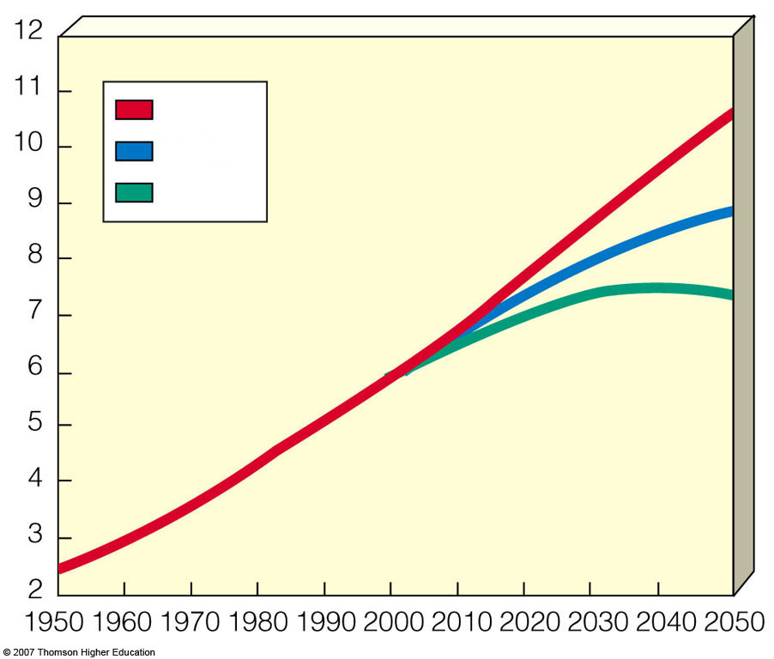
High
High
10.6
Medium
Low
Medium
8.9
Population (billions)
Low
7.2
Year
Notes:
Figure 9.2
Global connections: UN world population projections, assuming that by 2050 women have an average of 2.5 children (high), 2.0 children (medium), or 1.5 children (low). The most likely projection is the medium one—8.9 billion by 2050. (Data from United Nations, World Population Prospects: The 2001 Revision, 2002)

Slide 7

FACTORS AFFECTING HUMAN POPULATION SIZE
Population increases because of births and immigration and decreases through deaths and emigration.
Instead of using raw numbers, crude birth rates and crude death rates are used (based on total number of births or deaths per 1,000 people in a population).

Slide 8
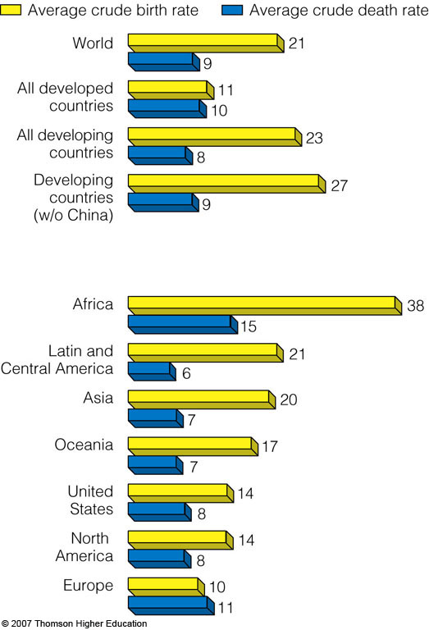
FACTORS AFFECTING HUMAN POPULATION SIZE
Average crude and birth rates for various groupings of countries in 2006.

Slide 9
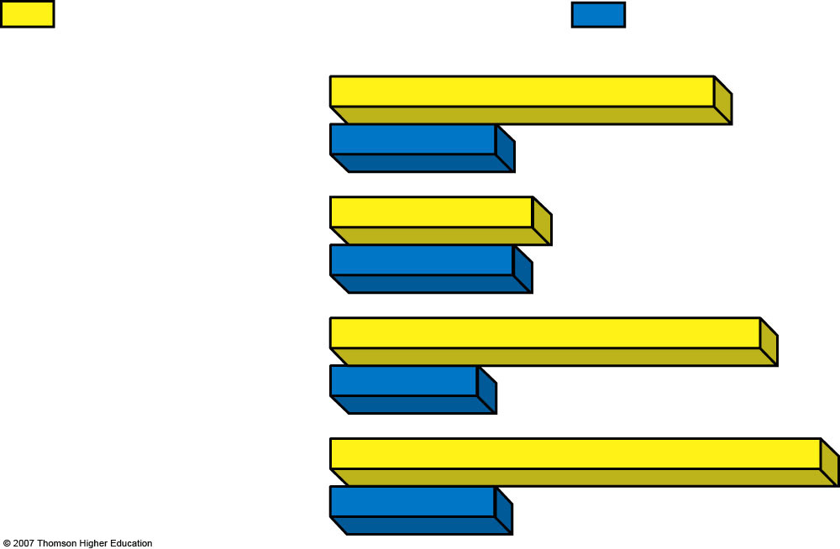
Average crude birth rate
Average crude death rate
World
21
9
All developed
countries
11
10
All developing
countries
23
8
Developing
countries
(w/o China)
27
9
Notes:
Figure 9.3
Global connections: average crude birth and death rates for various groupings of countries in 2006. (Data from Population Reference Bureau)

Slide 10
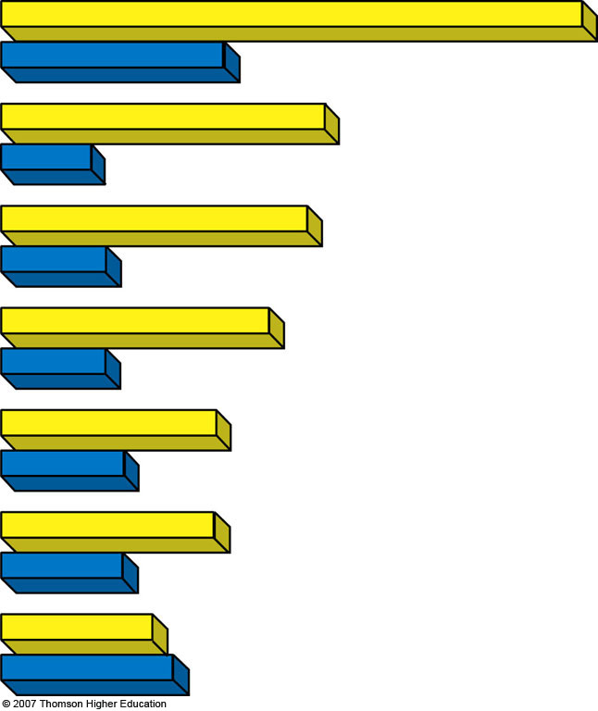
Africa
38
15
Latin and
Central America
21
6
Asia
20
7
Oceania
17
7
United
States
14
8
North
America
14
8
Europe
10
11
Notes:
Figure 9.3
Global connections: average crude birth and death rates for various groupings of countries in 2006. (Data from Population Reference Bureau)

Slide 11
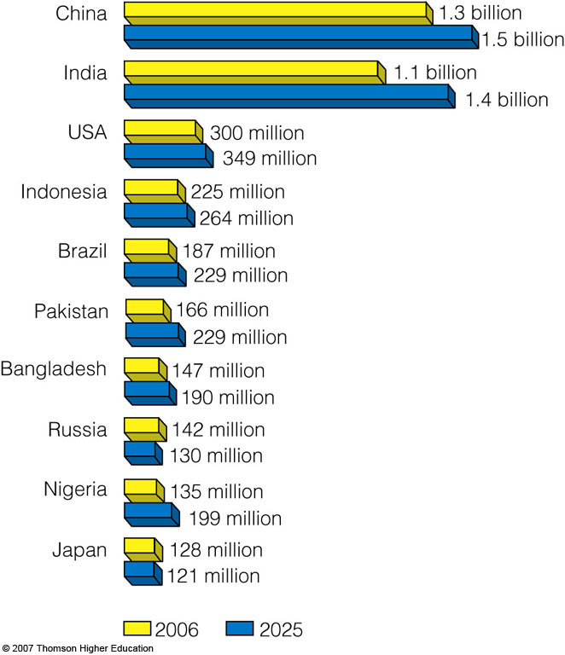
FACTORS AFFECTING HUMAN POPULATION SIZE
The world’s 10 most populous countries in 2006 with projections in 2025.

Slide 12
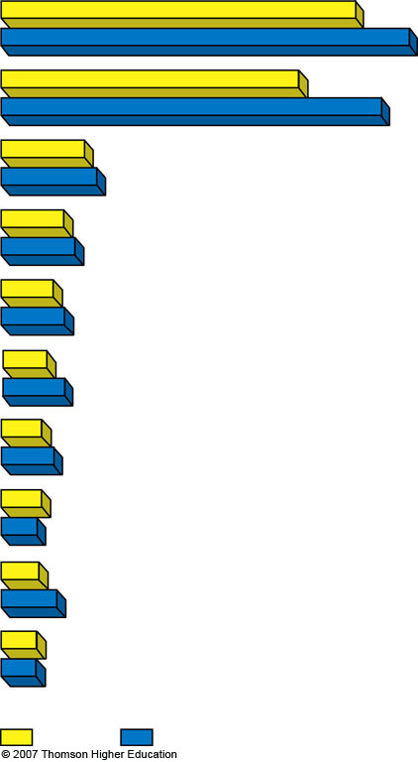
China
1.3 billion
1.5 billion
India
1.1 billion
1.4 billion
USA
300 million
349 million
Indonesia
225 million
264 million
Brazil
187 million
229 million
Pakistan
166 million
229 million
Bangladesh
147 million
190 million
Russia
142 million
130 million
Nigeria
135 million
199 million
Japan
128 million
121 million
2006
2025
Notes:
Figure 9.4
Global connections: the world’s 10 most populous countries in 2006, with projections of their population size in 2025. In 2006, more people lived in China than in all of Europe, Russia, North America, Japan, and Australia combined. By 2050, India is expected to have a larger population than China. (Data from World Bank and Population Reference Bureau)

Slide 13
Declining Fertility Rates:
Fewer Babies per Women
The average number of children that a woman bears has dropped sharply.
This decline is not low enough to stabilize the world’s population in the near future.
  Replacement-level fertility: the number of children a couple must bear to replace themselves.
  Total fertility rate (TFR): the average number of children a woman has during her reproductive years.

Slide 14
Declining Fertility Rates:
Fewer Babies per Women
The replacement level to sustain a population is 2.0 children.
In 2006, the average global Total Fertility Rate was 2.7 children per woman.
  1.6 in developed countries (down from 2.5 in 1950).
  3.0 in developing countries (down from 6.5 in 1950).

Slide 15
Case Study: Fertility and Birth Rates in the United States
Nearly 2.9 million people were added to the U.S. in 2006:
  59% occurred because of births outnumbering deaths.
  41% came from illegal and legal immigration.

Slide 16
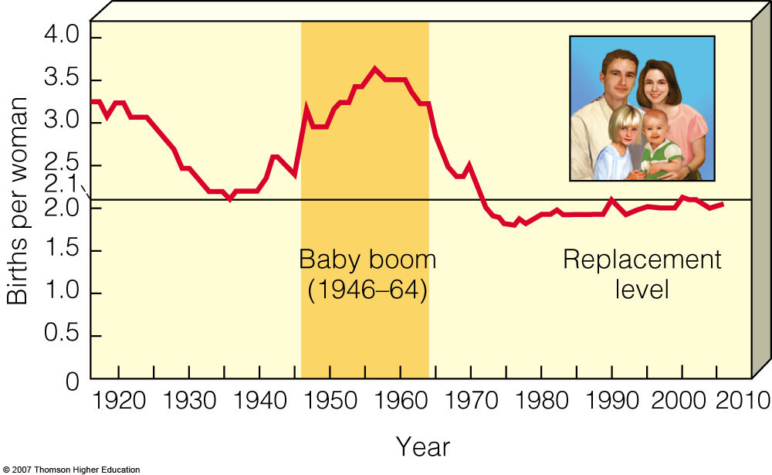
Case Study: Fertility and Birth Rates in the United States
In 2006, the total fertility rate in the United States was slightly > 2.0

Slide 17
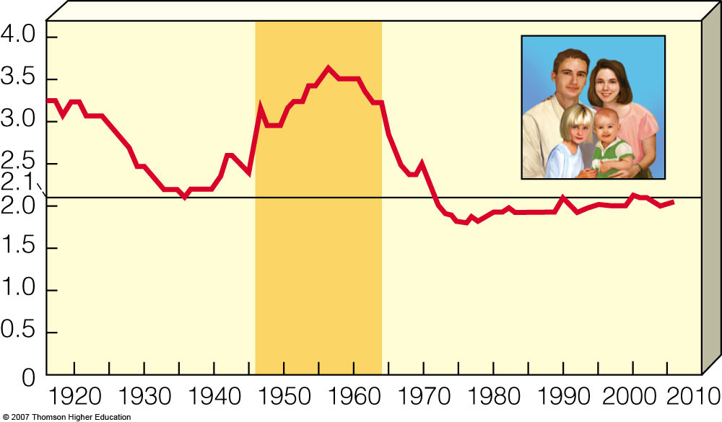
Births per woman
Baby boom
(1946–64)
Replacement
Level
Year
Notes:
Figure 9.5
Total fertility rates for the United States between 1917 and 2006. Use this figure to trace changes in total fertility rates during your lifetime. QUESTION: How many children do you plan to have? (Data from Population Reference Bureau and U.S. Census Bureau)

Slide 18
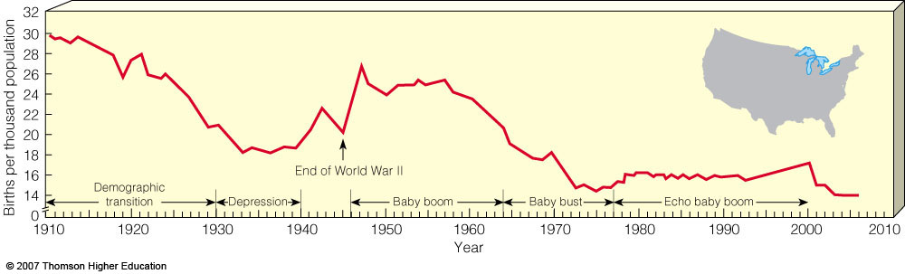
Case Study: Fertility and Birth Rates in the United States
The baby bust that followed the baby boom was largely due to delayed marriage, contraception, and abortion.

Slide 19
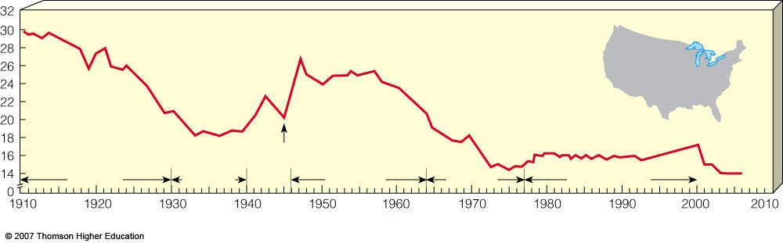
Births per thousand population
Demographic transition
End of World War II
Depression
Baby boom
Baby bust
Echo baby boom
Year
Notes:
Figure 9.6
Birth rates in the United States, 1910–2006. Use this figure to trace changes in crude birth rates during your lifetime. (Data from U.S. Bureau of Census and U.S. Commerce Department)

Slide 20
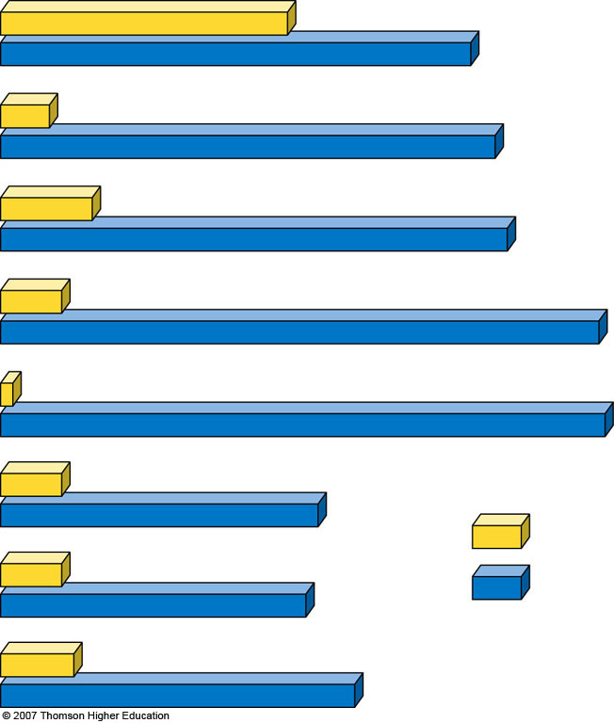
Life expectancy
47 years
77 years
Married women working
outside the home
8%
81%
High school
graduates
15%
83%
Homes with
flush toilets
10%
98%
Homes with
electricity
2%
99%
Living in
suburbs
10%
52%
1900
Hourly manufacturing job wage (adjusted for inflation)
$3
$15
2000
Homicides per
100,000 people
1.2
5.8
Notes:
Figure 9.7
Some major changes that took place in the United States between 1900 and 2000. QUESTION: Which two of these changes do you think were the most important? (Data from U.S. Census Bureau and Department of Commerce)

Slide 21
Factors Affecting Birth Rates and Fertility Rates
The number of children women have is affected by:
  The cost of raising and educating them.
  Availability of pensions.
  Urbanization.
  Education and employment opportunities.
  Infant deaths.
  Marriage age.
  Availability of contraception and abortion.

Slide 22
Factors Affecting Death Rates
Death rates have declined because of:
  Increased food supplies, better nutrition.
  Advances in medicine.
  Improved sanitation and personal hygiene.
  Safer water supplies.
U.S. infant mortality is higher than it could be (ranked 46th world-wide) due to:
  Inadequate pre- and post-natal care for poor.
  Drug addiction.
  High teenage birth rate.

Slide 23
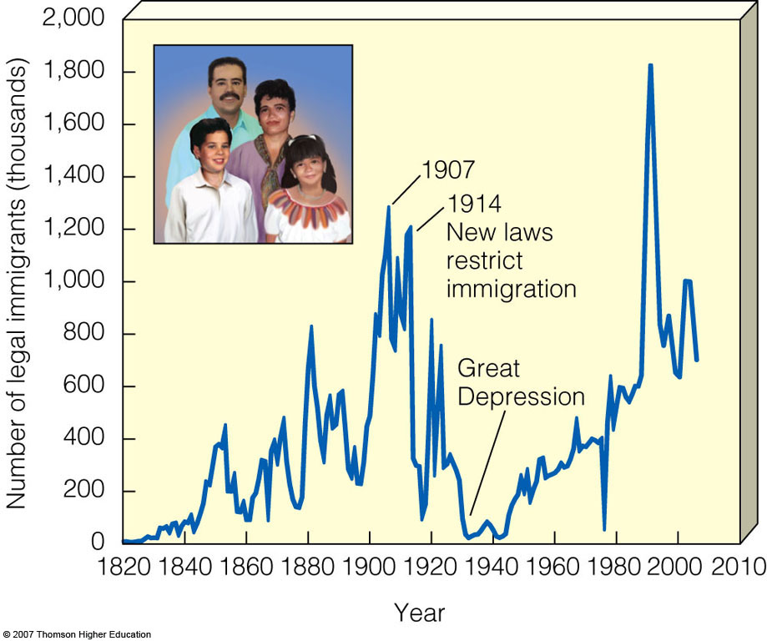
Case Study: U.S. Immigration
Since 1820, the U.S. has admitted almost twice as many immigrants and refugees as all other countries combined.

Slide 24
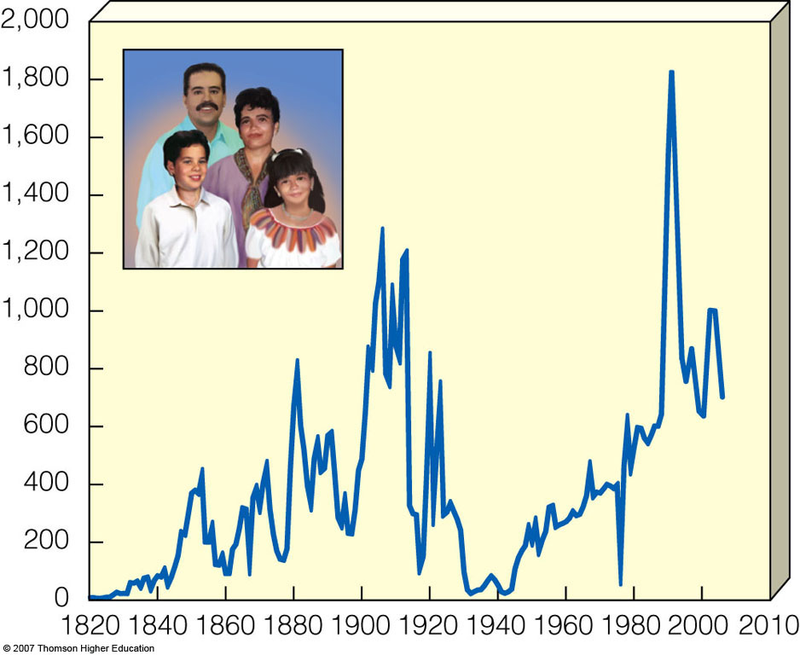
1907
1914
New laws
restrict
Immigration
Number of legal immigrants (thousands)
Great
Depression
Year
Notes:
Figure 9.8
Legal immigration to the United States, 1820–2003. The large increase in immigration since 1989 resulted mostly from the Immigration Reform and Control Act of 1986, which granted legal status to illegal immigrants who could show they had been living in the country for several years. (Data from U.S. Immigration and Naturalization Service and the Pew Hispanic Center)

Slide 25
How Would You Vote?
Should legal immigration into the United States (or the country where you live) be reduced?
  a) Yes: Because of threats of terrorism and the burden on the economy, immigration should be reduced.
  b) No. Humane efforts should be made to curtail illegal immigration, but our economy needs legal immigrants.
  c) Other. Explain

Slide 26
POPULATION AGE STRUCTURE
The number of people in young, middle, and older age groups determines how fast populations grow or decline.
The number of people younger than age 15 is the major factor determining a country’s population growth.
Changes in the distribution of a country’s age groups have long-lasting economic and social impacts.

Slide 27
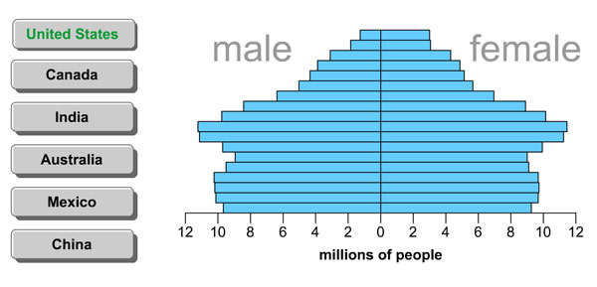
Animation: Examples of Age Structure
PLAY
ANIMATION

Slide 28
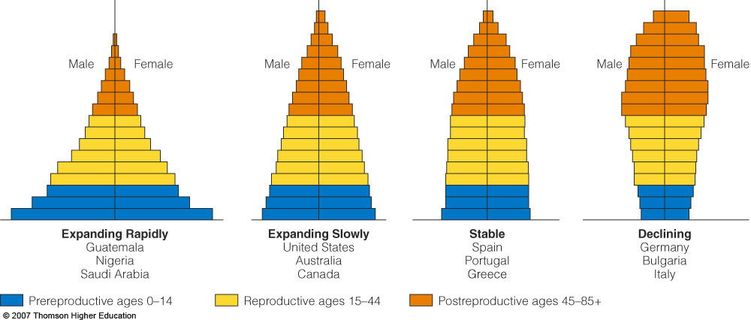
POPULATION AGE STRUCTURE
Populations with a large proportion of its people in the preproductive ages 1-14 have a large potential for rapid population growth.

Slide 29
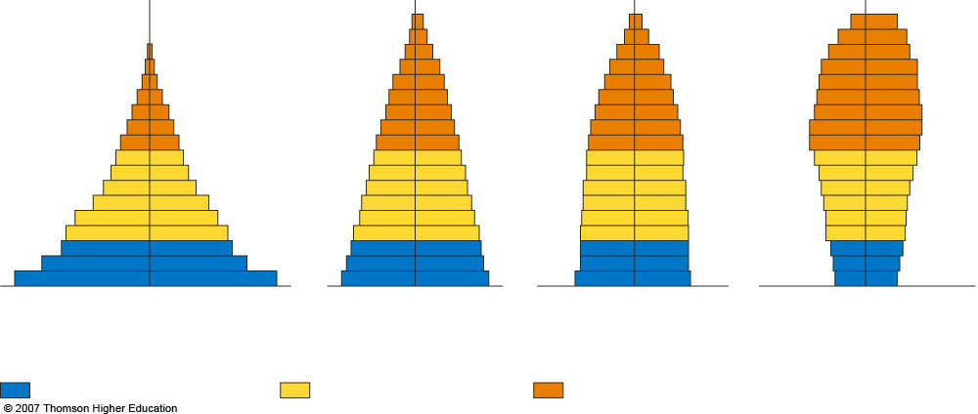
Male
Female
Male
Female
Male
Female
Male
Female
Expanding Rapidly
Guatemala
Nigeria
Saudi Arabia
Expanding Slowly
United States
Australia
Canada
Stable
Spain
Portugal
Greece
Declining
Germany
Bulgaria
Italy
Prereproductive ages 0–14
Reproductive ages 15–44
Postreproductive ages 45–85+
Notes:
Figure 9.9
Generalized population age structure diagrams for countries with rapid (1.5–3%), slow (0.3–1.4%), zero (0–0.2%), and negative population growth rates (a declining population). Populations with a large proportion of its people in the prereproductive ages of 1–14 (at left) have a large potential for rapid population growth. QUESTION: Which of these diagrams best represents the country where you live? (Data from Population Reference Bureau)

Slide 30
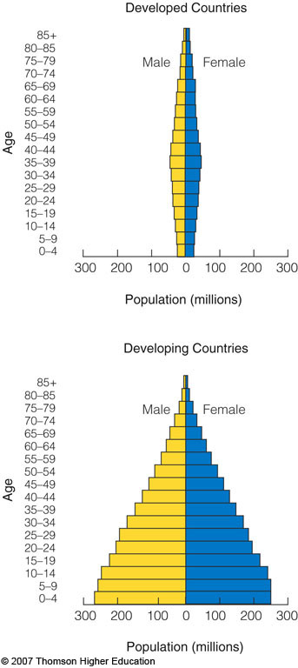
POPULATION AGE STRUCTURE
32% of the people in developing countries were under 15 years old in 2006 versus only 17% in developed countries.

Slide 31
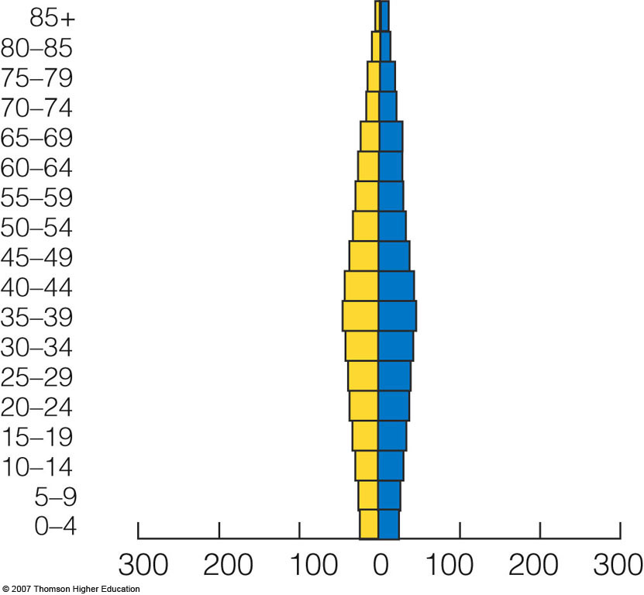
Developed Countries
Male
Female
Age
Population (millions)
Notes:
Figure 9.10
Global connections: population structure by age and sex in developing countries and developed countries, 2006. (Data from United Nations Population Division and Population Reference Bureau)

Slide 32
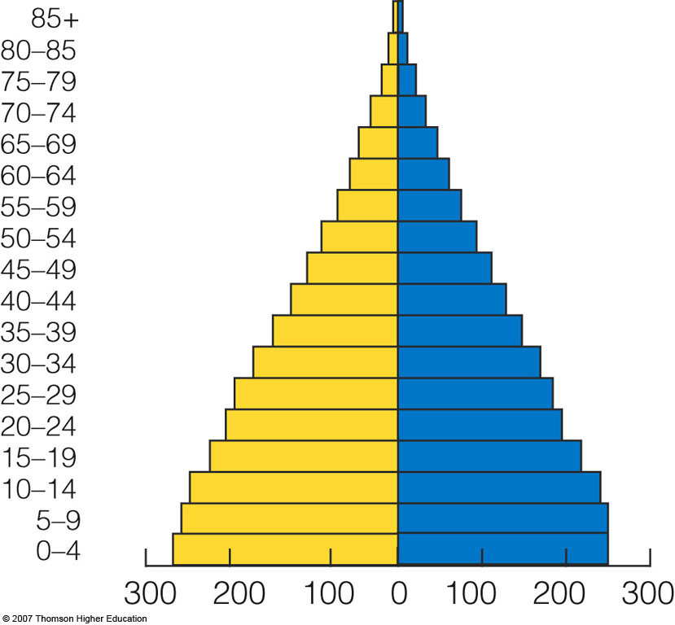
Developing Countries
Male
Female
Age
Population (millions)
Notes:
Figure 9.10
Global connections: population structure by age and sex in developing countries and developed countries, 2006. (Data from United Nations Population Division and Population Reference Bureau)

Slide 33
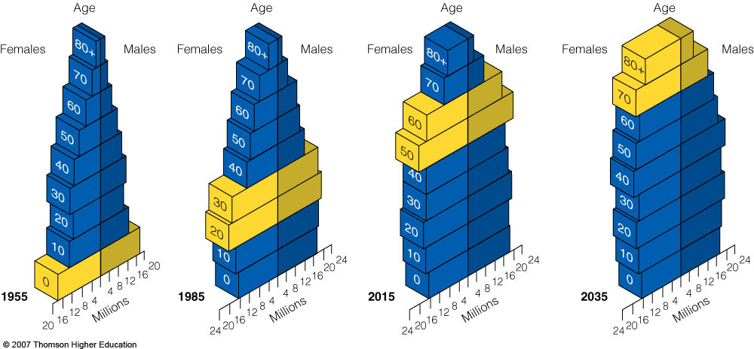
POPULATION AGE STRUCTURE
Today, baby boomers make up nearly half of all adult Americans and dominate the populations demand for goods and services.

Slide 34
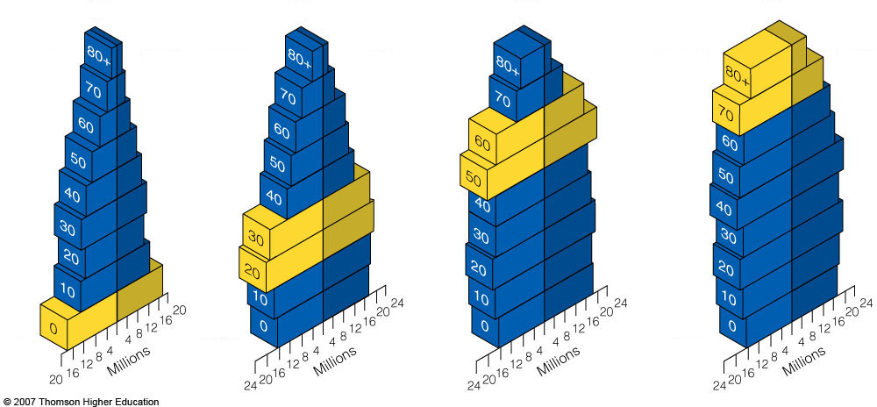
Age
Age
Age
Age
Females
Males
Females
Males
Females
Males
Females
Males
1955
1985
2015
2035
Notes:
Figure 9.11
Tracking the baby-boom generation in the United States. (Data from Population Reference Bureau and U.S. Census Bureau)

Slide 35
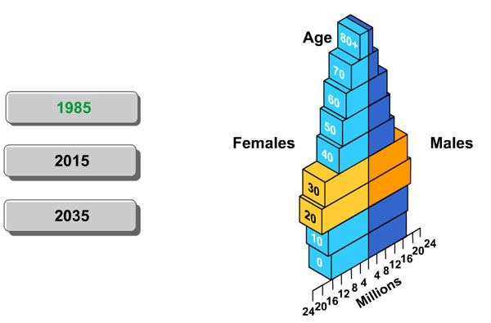
Animation: U.S. Age Structure
PLAY
ANIMATION

Slide 36
POPULATION AGE STRUCTURE
About 14% of the world’s population live in countries with stabilizing or declining populations.
Rapid population decline can lead to long-lasting economic and social problems.
Death from AIDS can disrupt a country’s social and economic structure by removing significant numbers of young adults.
Global again may help promote peace.

Slide 37
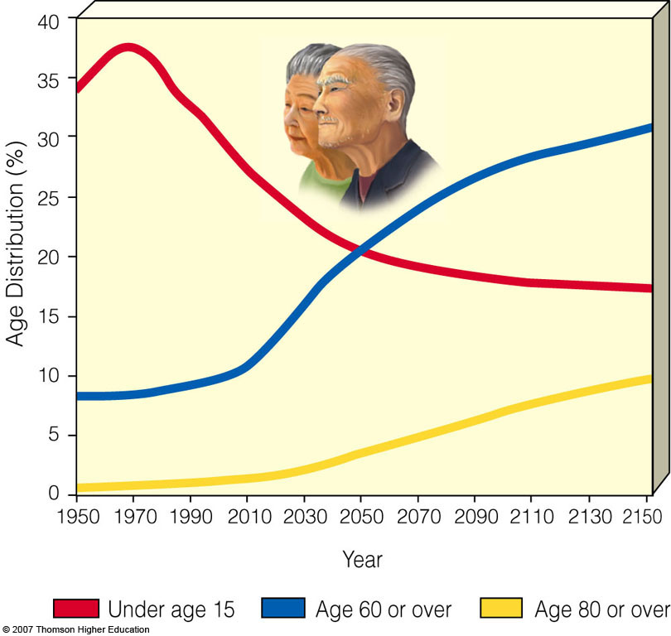
POPULATION AGE STRUCTURE
Age structure predictions based on a medium fertility projection.
The cost of an aging population will strain the global economy.

Slide 38
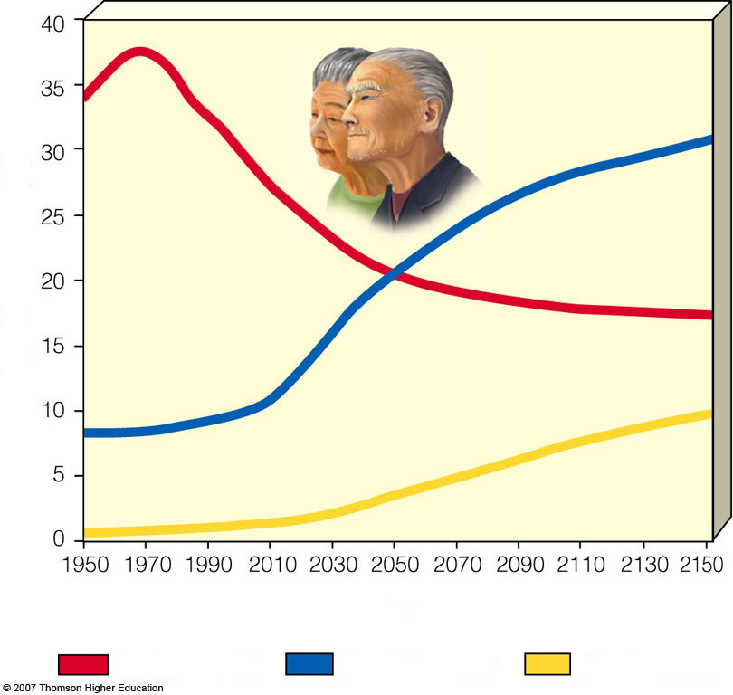
Age Distribution (%)
Year
Under age 15
Age 60 or over
Age 80 or over
Notes:
Figure 9.12
Global aging. Projected percentage of world population under age 15, age 60 or over, and age 80 or over, 1950–2150, assuming the medium fertility projection shown in Figure 9-2. The cost of supporting a much larger elderly population will place enormous strains on many nations and the global economy. (Data from the United Nations)

Slide 39

Video: Bonus For A Baby
PLAY
VIDEO

Slide 40

POPULATION AGE STRUCTURE
Some problems with rapid population decline.

Slide 41

• Can threaten economic growth
• Less government revenues with
fewer workers
• Less entrepreneurship and new
business formation
• Less likelihood for new technology development
• Increasing public deficits to fund higher pension and healthcare costs
Notes:
Figure 9.13
Some problems with rapid population decline. QUESTION: Which three of these problems do you believe are the most important?

Slide 42
SOLUTIONS: INFLUENCING POPULATION SIZE
Demographic Transition: As countries become economically developed, their birth and death rates tend to decline.
  Preindustrial stage: little population growth due to high infant mortality.
  Transitional stage: industrialization begins, death rates drops and birth rates remain high.
  Industrial stage: birth rate drops and approaches death rate.

Slide 43
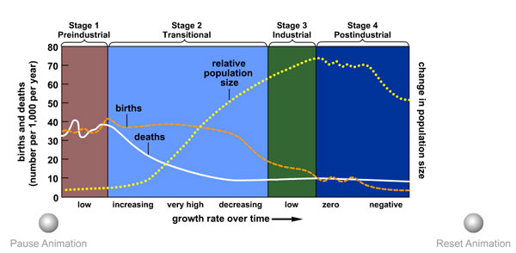
Animation: Demographic Transition Model
PLAY
ANIMATION

Slide 44
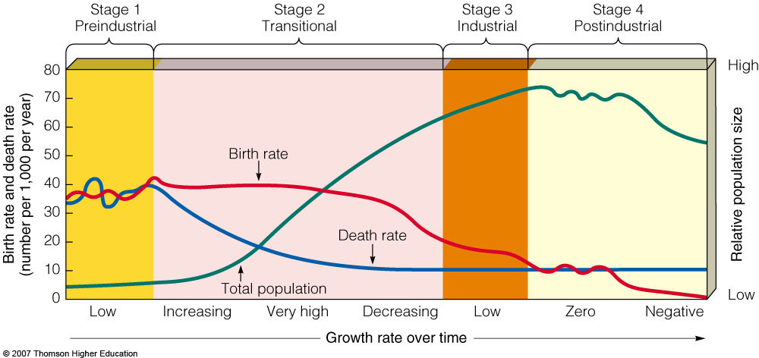
SOLUTIONS: INFLUENCING POPULATION SIZE
Generalized model of demographic transition.
  Some developing countries may have difficulty making the demographic transition.

Slide 45
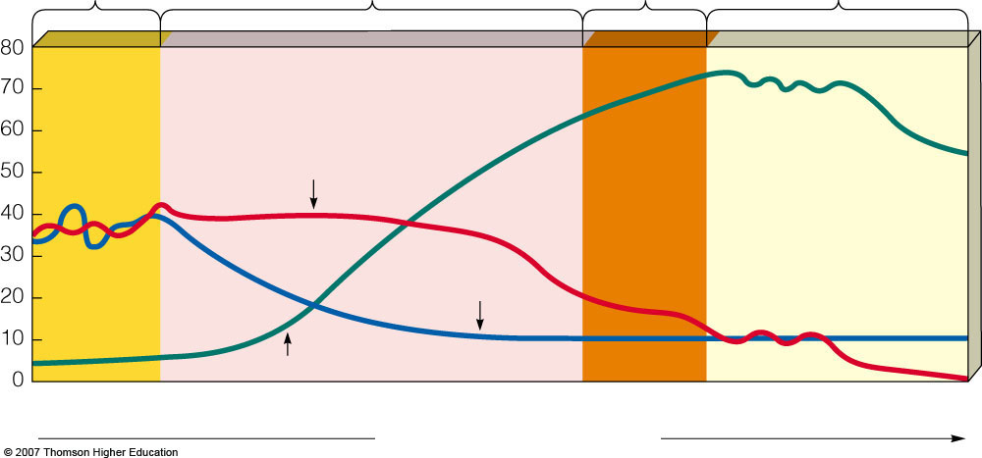
Stage 1
Preindustrial
Stage 2
Transitional
Stage 3
Industrial
Stage 4
Postindustrial
High
Birth rate
Birth rate and death rate
(number per 1,00 per year)
Relative population size
Death rate
Total population
Low
Low
Increasing
Very high
Decreasing
Low
Zero
Negative
Growth rate over time
Notes:
Figure 9.14
Generalized model of the demographic transition. There is uncertainty over whether this model will apply to some of today’s developing countries. QUESTION: At what stage is the country where you live?

Slide 46
SOLUTIONS: INFLUENCING POPULATION SIZE
Family planning has been a major factor in reducing the number of births and abortions throughout most of the world.
Women tend to have fewer children if they are:
  Educated.
  Hold a paying job outside the home.
  Do not have their human right suppressed.

Slide 47
SOLUTIONS: INFLUENCING POPULATION SIZE
The best way to slow population growth is a combination of:
  Investing in family planning.
  Reducing poverty.
  Elevating the status of women.

Slide 48
SLOWING POPULATION GROWTH IN INDIA AND CHINA
For more than five decades, India has tried to control its population growth with only modest success.
Since 1970, China has used a government-enforced program to cut its birth rate in half and sharply reduce its fertility rate.

Slide 49
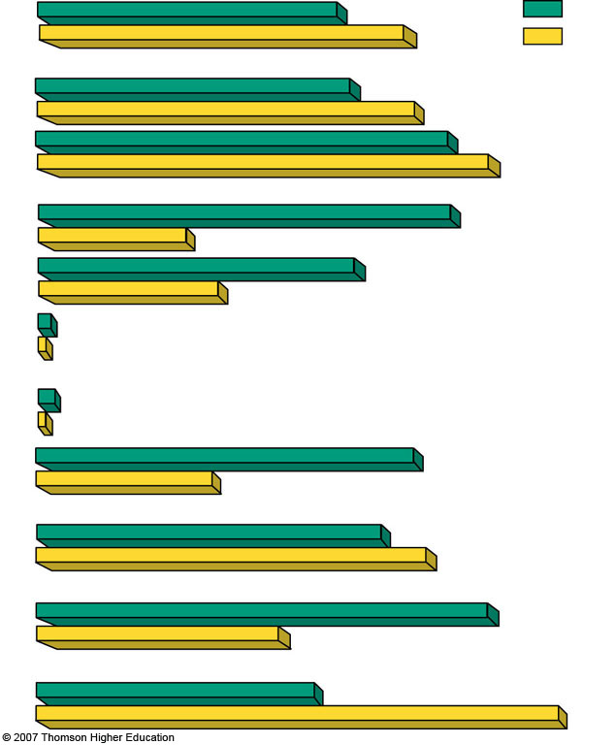
Percentage
of world
population
17%
India
20%
China
Population
1.1 billion
1.3 billion
Population (2050)
(estimated)
1.4 billion
1.6 billion
Illiteracy (% of adults)
47%
17%
Population under age 15 (%)
36%
20%
Population growth rate (%)
1.6%
0.6%
Total fertility rate
2.9 children per women (down from 5.3 in 1970)
1.6 children per women (down from 5.7 in 1972)
Infant mortality rate
58
27
62 years
Life expectancy
70 years
Percentage living
below $2 per day
80
47
GDP PPP per capita
$3,120
$5,890
Notes:
Figure 9.15
Global connection: basic demographic data for India and China in 2006. (Data from United Nations and Population Reference Bureau)

Slide 50
India’s Failed
Family Planning Program
Poor planning.
Bureaucratic inefficiency.
Low status of women.
Extreme poverty.
Lack of administrative financial support.
Disagreement over the best ways to slow population growth.

Slide 51
China’s Family Planning Program
Currently, China’s TFR is 1.6 children per women.
China has moved 300 million people out of poverty.
Problems:
  Strong male preference leads to gender imbalance.
  Average population age is increasing.
  Not enough resource to support population.

Slide 52
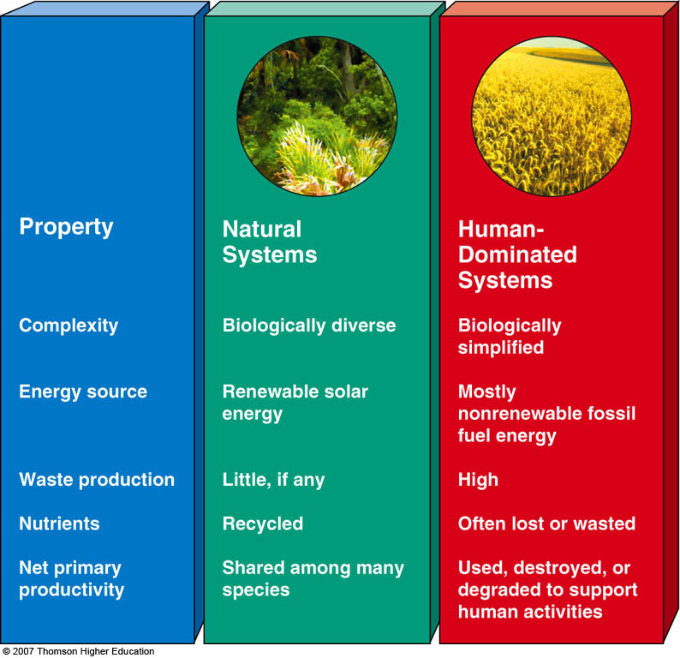
HUMAN ASPECTS ON
NATURAL SYSTEMS
Excluding Antarctica, human activities have affect about 83% of the earths land surface.

Slide 53

Property
Natural
Systems
Human-Dominated Systems
Complexity
Energy source
Waste production
Nutrients
Net primary productivity
Biologically diverse
Renewable solar energy
Little, if any
Recycled
Shared among many species
Biologically simplified
Mostly nonrenewable fossil fuel energy
High
Often lost or wasted
Used, destroyed, or degraded to support human activities
Notes:
Figure 9.16
Some typical characteristics of natural and human-dominated systems. Many human activities threaten local ecological processes and some bring about harmful regional and global changes.

Slide 54
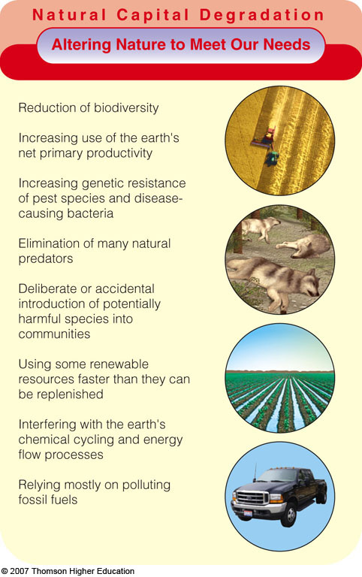
HUMAN ASPECTS ON
NATURAL SYSTEMS
We have used technology to alter much of the rest of nature in ways that threaten the survival of many other species and could reduce the quality of life for our own species.

Slide 55
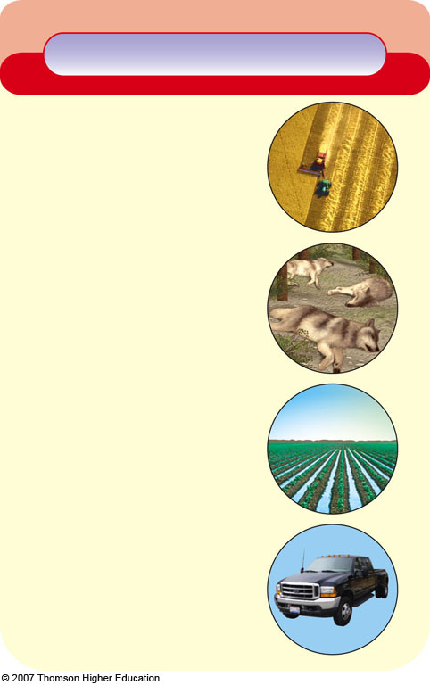
Natural Capital Degradation
Altering Nature to Meet Our Needs
Reduction of biodiversity
Increasing use of the earth's net primary productivity
Increasing genetic resistance of pest species and disease-causing bacteria
Elimination of many natural predators
Deliberate or accidental introduction of potentially harmful species into communities
Using some renewable resources faster than they can be replenished
Interfering with the earth's chemical cycling and energy flow processes
Relying mostly on polluting fossil fuels
Fig. 9-17, p. 188
Notes:
Figure 9.17
Natural capital degradation: major ways humans have altered the rest of nature to meet our growing population, needs, and wants. QUESTIONS: Which three of these items do you believe have been the most harmful? How does your lifestyle contribute directly or indirectly to each of these items?

Slide 56

Animation: Resources Depletion and Degradation
PLAY
ANIMATION

